Slide 1
World Soccer Transfer Market
David Parsons

Slide 2

Business Case
World soccer markets generate billions in revenue each year.
Big Five leagues over 15b
Quickest way to improve team via transfer market
A transfer is when one team pays another for the right to give their player a contract

Slide 3
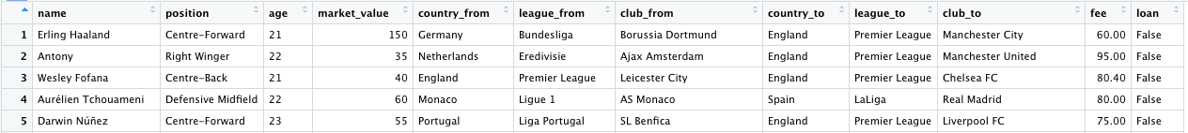
Data Overview
Downloaded from Kaggle.com
2000 instances of a player changing team in Summer 2022 transfer window with 12 variables

Slide 4
Transfer Analysis
ARM
Naïve Bayes and SVM
Kmeans Clustering

Slide 5
ARM
Top Market Rules
League Specific Rules
Star Player Rules

Slide 6
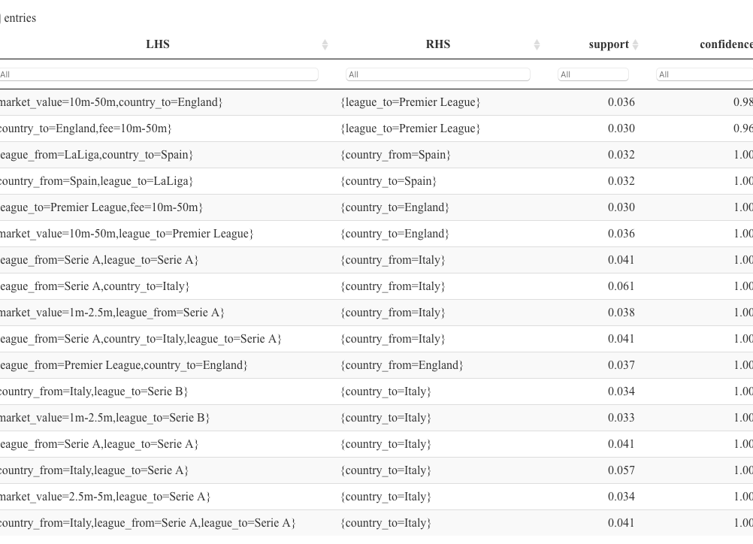
Top Overall Rules
Most popular rules had version of country to/from league rules
A few exceptions
Players worth 10m – 50 m going to the Premier League
Lower valued players going to Italy

Slide 7
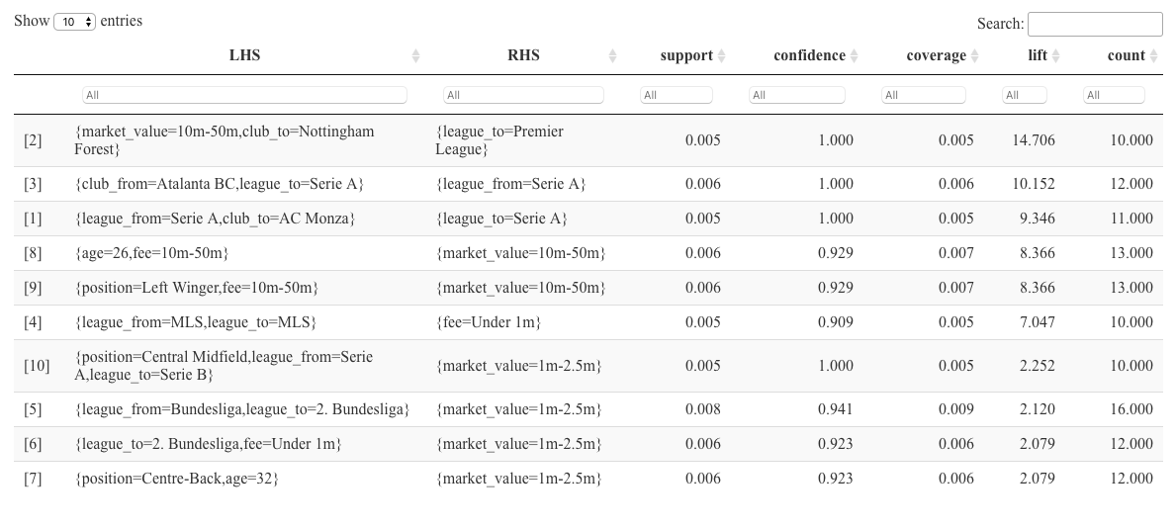
Top Non-Country to League Rules
Removed country data to get more interesting rules
Nottingham Forrest bought the highest valued players
Left Wingers and aged 26 players were highly valued

Slide 8
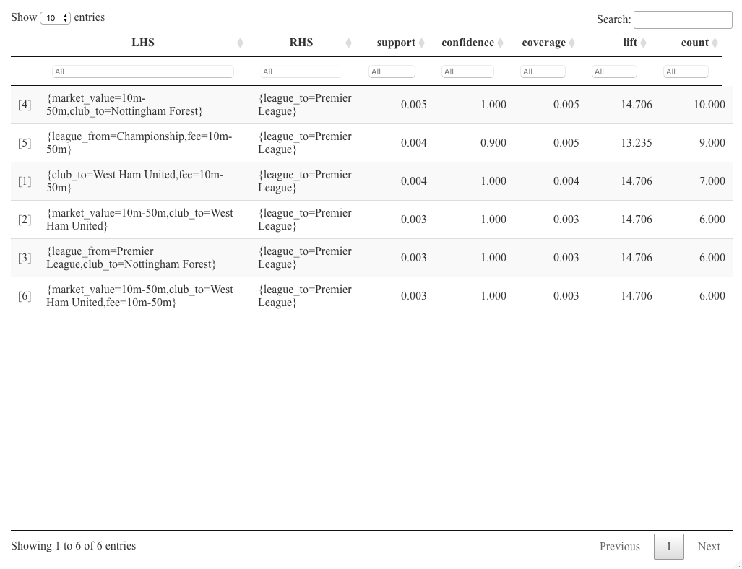
Premier League Rules
Nottingham Forrest and West Ham bought the most high valued players
The league with the most players bought from was the Championship (league below PL)

Slide 9
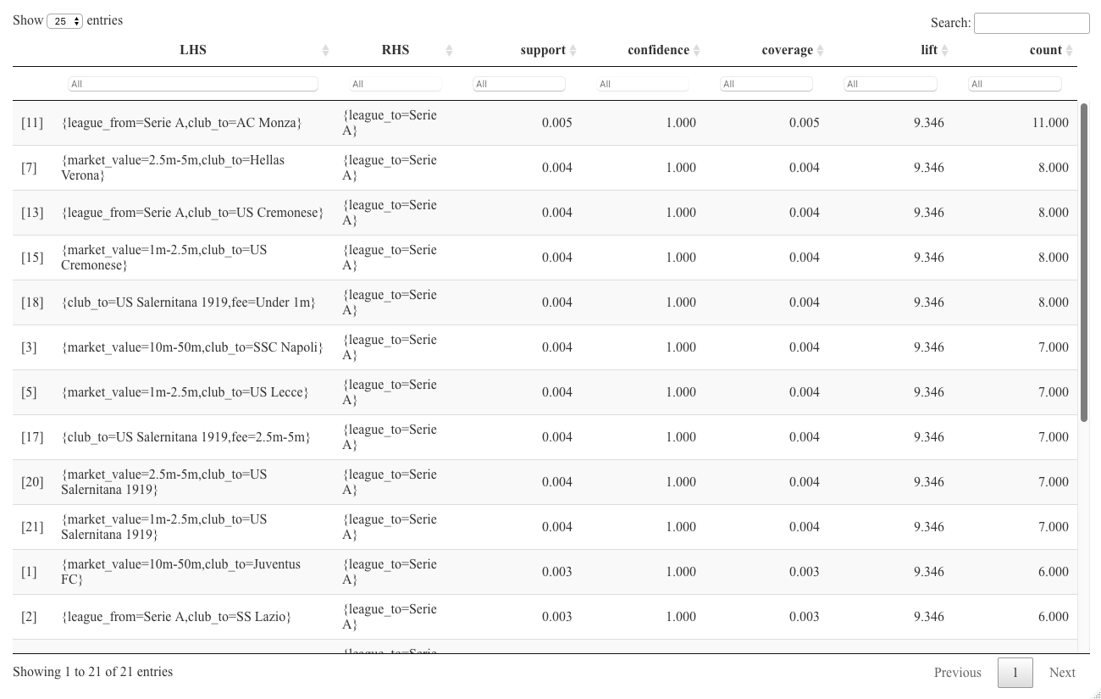
Serie A Rules
Serie A mainly bought and sold players within Italy
Most of the moves in Serie A were were under 5m for clubs outside of Juventus and Napoli
Buying in bulk:
Salernitana bought 6 Centre-Forwards
Udinese bought 6 Left-Backs

Slide 10
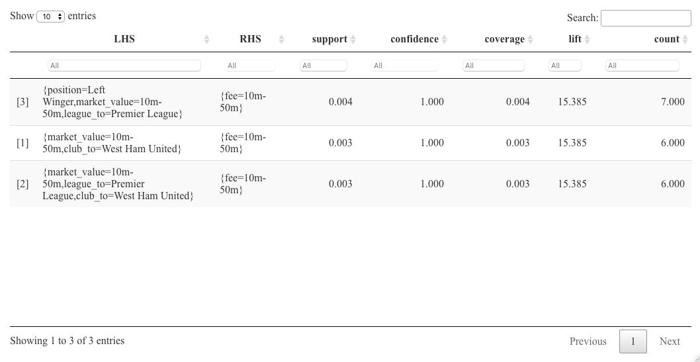
Star Player Rules
The Premier League had an influx of star left wingers
West Ham bought the most high-priced players

Slide 11
Naïve Bayes and SVM
Predicting the transfer fee
Forecasting the league a player will go to

Slide 12
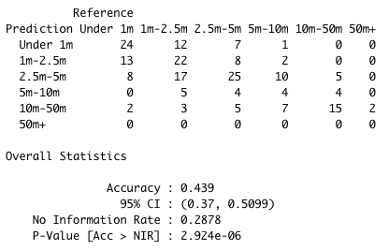
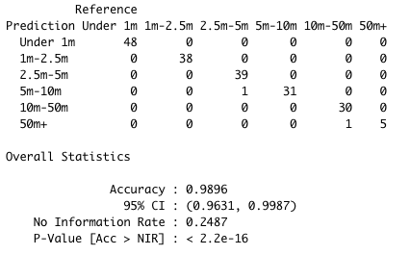
Naïve Bayes and SVM Prediction for Transfer Fees
Naïve Bayes
SVM
Naïve Bayes model performed with a 43% accuracy
SVM model perform with 99% accuracy

Slide 13
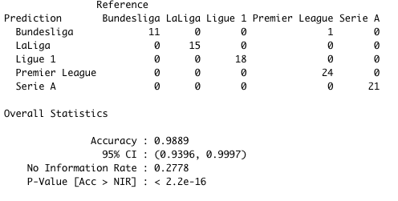
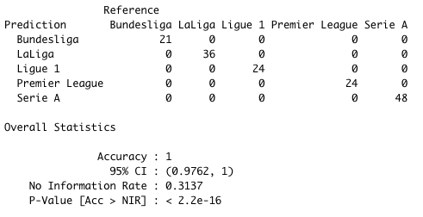
Naïve Bayes and SVM Prediction for League To
Naïve Bayes
SVM
Both models performed better in determining the league a player goes to
The Naïve Bayes model had 99% accuracy and the SVM model was at 100%

Slide 14
Kmeans Clustering
How are star player movements classified?
Where are the new Premier League players moving?

Slide 15
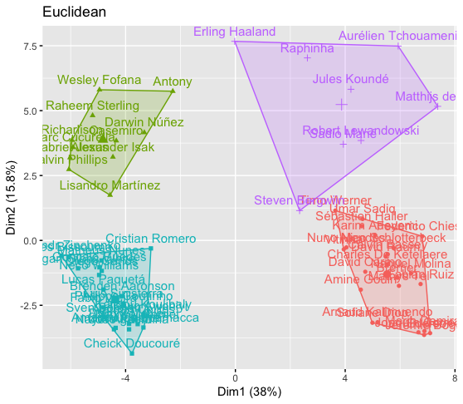
Star Player Clustering
The transfer of the star players could be broken into 4 clusters
Green: Most expensive Premier League Players (50m+)
Teal: Less Expensive Premier League Players (20m to 50m)
Purple: Expensive non-PL players
Red: Less expensive non-PL players

Slide 16
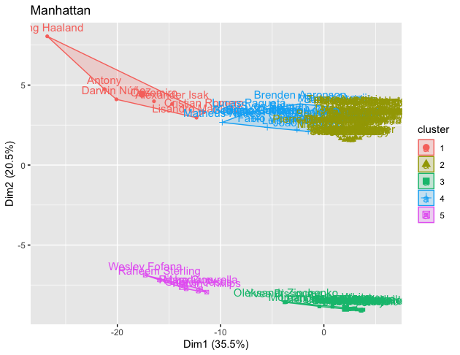
Premier League Clustering
PL transfer broke into 5 clusters
Red: Expensive players coming from outside PL
Blue: Medium cost players outside PL
Yellow: Cheap players outside PL
Purple: Expensive players inside PL
Green: Cheaper players inside PL

Slide 17
Conclusion and Future Analysis
Conclusion
Leagues mainly move players within their leagues, possible bargains when looking outside league
Successful prediction models for transfer fees can be used in future transfer window
Transfer can be grouped into distinct clusters. This can be used to help determine which tier of players a club should target
Future Analysis
Current analysis focuses more on the transfer moves
Possibilities to use team needs using club and player data
Example: Team A struggles to score; which transfer targets could they acquire to fix that
Data available on https://fbref.com/en/

